Slide 1


REAL ESTATE

Slide 2
INTRODUCTION
The main objective of this project is to bring the real estate industry online and enabling real estate industry participants to benefit from the Internet. Site acts as an interface between Individuals, brokers and realtors. Here the user can advertise his property for buying or for selling.
Site provides online real-estate service committed to helping you make wise and profitable decisions related to buying, selling, renting and leasing of properties, in India. We will provide a fresh new approach to our esteemed users to search for properties to buy or rent, and list their properties for selling or leasing.

Slide 3
The search can be based on the Number of bed rooms.
Number of Wash rooms, price, area, city, plot size, type of property etc. Enter your search criteria and click the SEARCH button to display the matching property. When you click the search button the property advertised will be shown.
In the site we have different types of people, like broker, purchaser and owner.
We have to login as a specified fields and we have to provide information regarding to the property. The purchaser search the property based on his requirements. He got some information he can directly communicate with the people.

Slide 4

Introducing a website

Slide 5
MODULE DISCRIPTION
BUY MODULE-
In buy module a user can buy required property after searching and selecting based on his/her choice. He can check the localities of neaby area. The properties are shown to the user as per their locality choice.
The user can choose flats also and having the choices to select between 1BHK, 2BHK and 3BHK.
The user can also choose property as per their budget.
Here once you have entered your request for a particular property you will receive a conformation mail

Slide 6
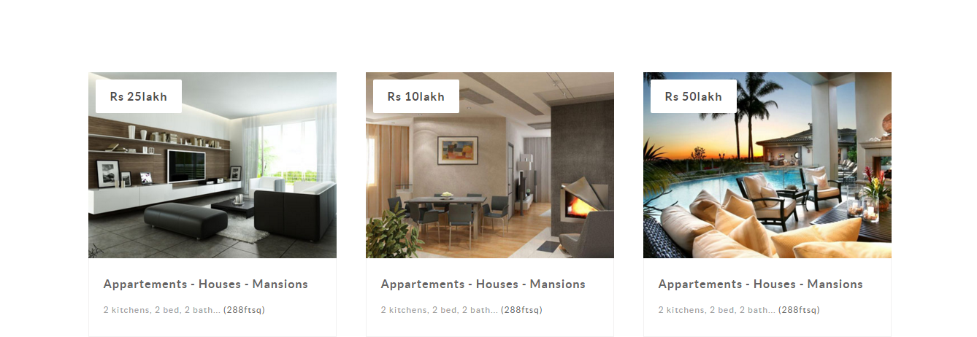
Buy Module

Slide 7
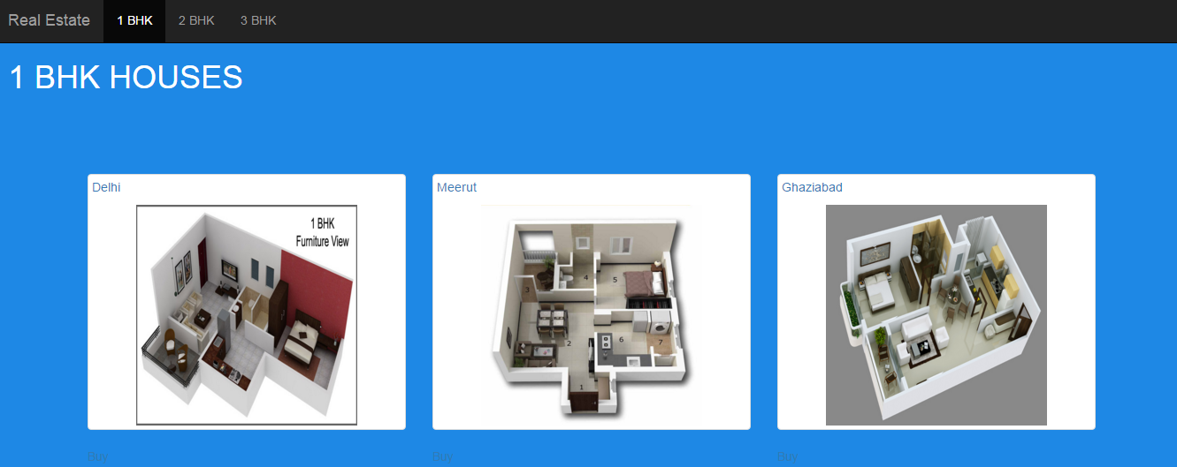

Slide 8
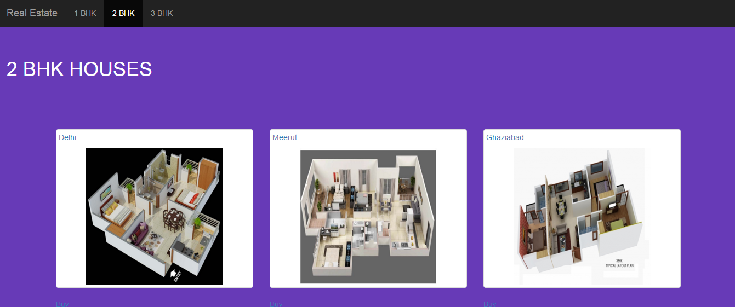

Slide 9
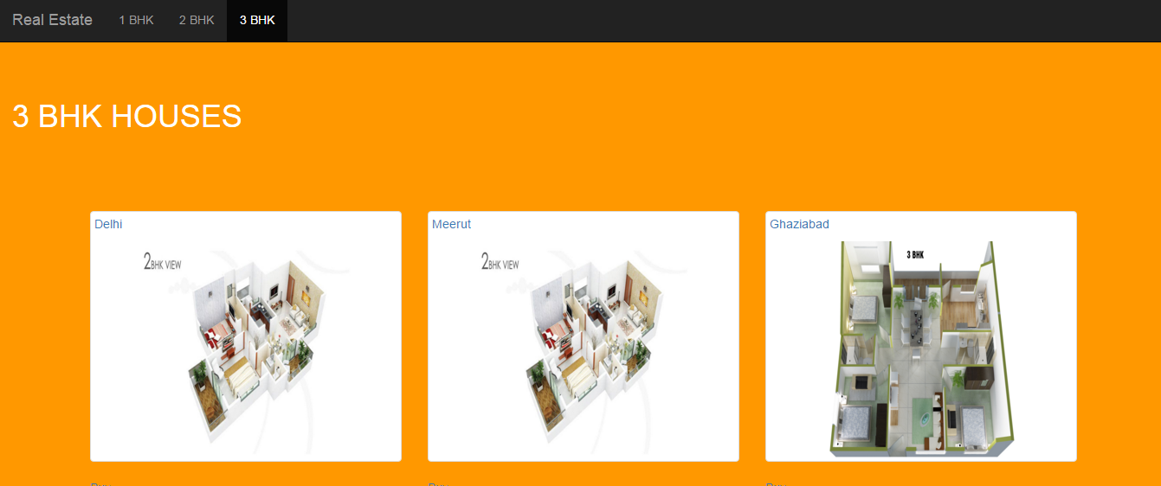

Slide 10
SELL MODULE-
They can do the following:
Create account/Sign Out.
Register property.
Confirmation sends through E-mail by administrator only when any customer is interested in his/her property.

Slide 11
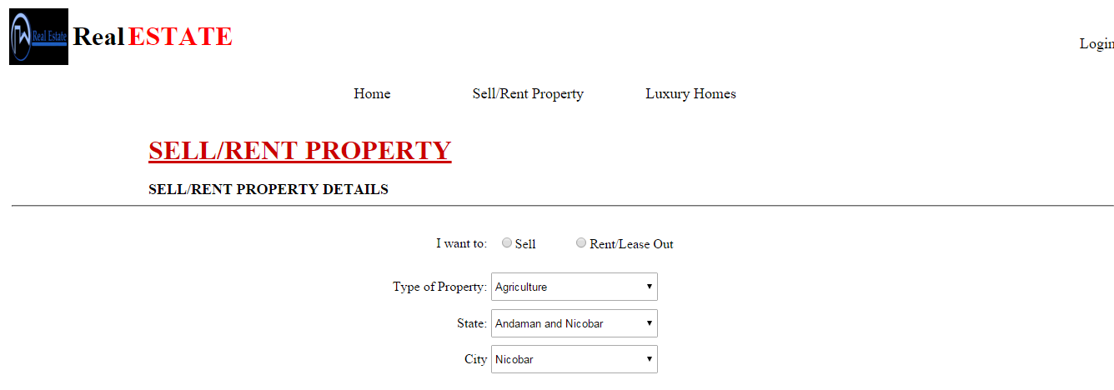

Slide 12
SEARCH MODULE-
In search module a user can search required property by selecting catagories based on his/her choice. He can check the localities of nearby area. The properties are shown to the user as per their locality choice.
The user can choose flats also and having the choices to select between 1BHK, 2BHK and 3BHK.
The user can also search property as per their budget.
Here once you have entered your request for a particular property you will receive a conformation mail.

Slide 13
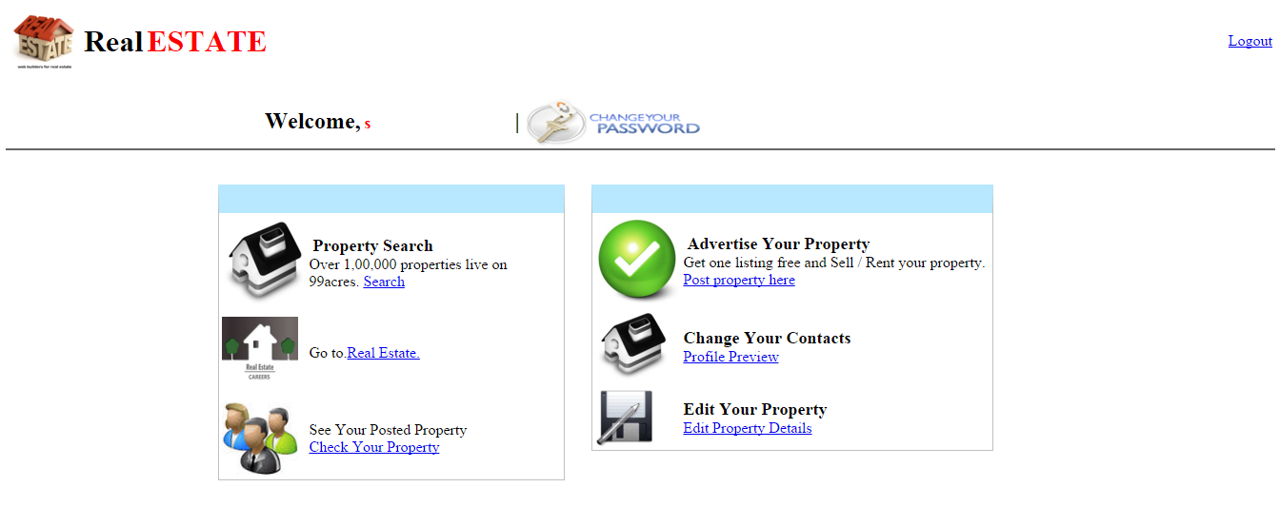

Slide 14
FEATURES
Manage your property search, Requirements and response. Get suggested listings on your mailbox.
Post your requirements. Join apartment community to connect with residents and the association. Know and pay your maintenance dues online. Quickly find the right vendor for your home need.

Slide 15
CONCLUSION
The project is to bring the real estate industry online and enabling real estate industry participants to benefit from the Internet. Site acts as an interface between Individuals, brokers and realtors. Here the user can advertise his property for buying or for selling.
Site provides online real-estate service committed to helping you make wise and profitable decisions related to buying, selling, renting and leasing of properties, in India. We will provide a fresh new approach to our esteemed users to search for properties to buy or rent, and list their properties for selling or leasing.

Slide 16
FUTURE IMPROVEMENTS
The feature improvements of the project are listed below.
Providing good search facilities based on certain location and place.
Direct communication through Audio or Video Chatting facilities.
Providing the information about the Real estates.
Approaching different Banks for Online money transaction.

Slide 17
THANK YOU
Made by:
1.Shubham chaudhary (1206813074)
2. Sanchit prajapati (1206813063)
3.Yaman chauhan (1206813090)
Class - I.T.-B
Sem - 8
Session- 2015-16

